Slide 1

Department of Computer and Information Science,
School of Science, IUPUI
CSCI 230
Variable Declarations, Data types, Expressions
- Variables and Operators
Dale Roberts, Lecturer
Computer Science, IUPUI
E-mail: droberts@cs.iupui.edu

Slide 2


Memory Concepts
Variables
  Variable names (identifiers) correspond to locations in the computer's memory (von Neuman model)
  Every variable has a name, a type, a size and a value
  Whenever a new value is placed into a variable (through scanf, for example), it replaces (and destroys) the previous value. (Destructive write)
  Reading variables from memory does not change them
A visual representation (memory map)
i
36443
variable
address
45
value
4 bytes
datatype
size
int

Slide 3
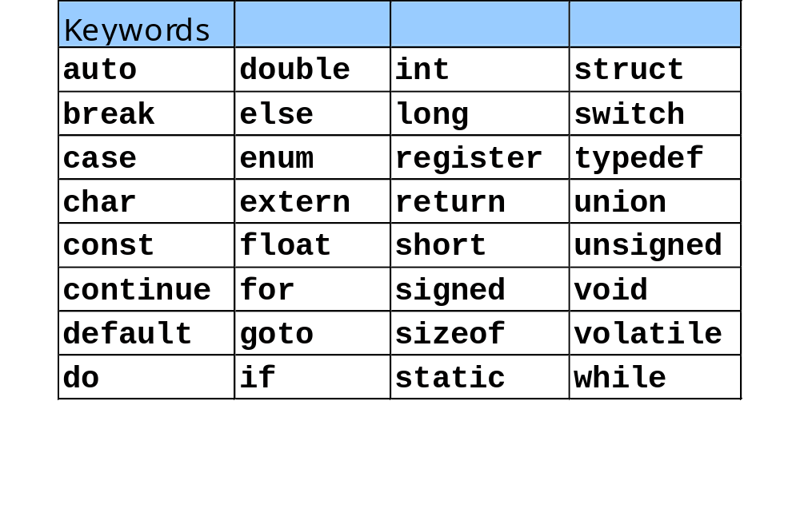
Keywords

Slide 4
Expression
Expressions are computations that return a value.
Like variables, a value is an instance of a data type.
Examples of expressions are:
  45 (int)
  2+3 (int)
  2.0/5.0 (double)
  “Hello” (string)
  x (the current value of variable int x)

Slide 5
Arithmetic Operators
Binary Operator (two operands)
  + (addition) - (subtraction) * (multiplication)
  / (division) % (modulus, remainder) (no ** )
Unary Operator (single operands)
  - (no + )
  Example:
    int i=1, j=2, k=3, x;
    x=i+2*j-22/k;
    x=-1+j;
    x=1+-j;
    x=+i+j;
    x=22%k;
    float f=1.5, g=0.5, y;
    y=2.5*f+4.0*g;
  Exercise: Try -5%3 -5%-3 5%-3
  (hint: -5/3=-1 -5/-3=1 5/-3=-1 and R=x-y*i)
  Mixed data types will be discussed later
  Operators that have more than two operands use functional notation a = f(x,y,x).
(x=1 + 4 -7 = -2)
(x= 1)
(x= -1)
(wrong expression)
(x= 1, remainder)
(y=5.75)
Ans: -2 -2 2

Slide 6
Arithmetic Operators
Arithmetic operators:
C operation
Arithmetic
Algebraic
C expression
operator
expression
Addition
+
f + 7
f + 7
Subtraction
-
p
–
c
p
-
c
Multiplication
*
bm
b * m
Division
/
x / y
x / y
Modulus
%
r mod s
r % s

Slide 7
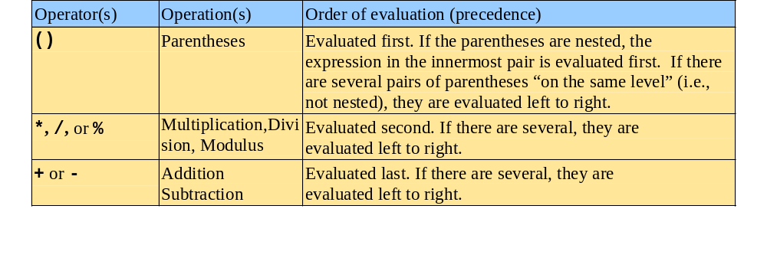
Precedence

Slide 8
Relational Operators
Binary Operators
  == != < > <= >=
  Result is a integer: 1 means TRUE
  0 means FALSE
  No logical type variable and constants
  No space between the operators
  Example:
Meaning | C | Expression | Result
equal not equal greater less greater equal less equal | == != > < >= <= | 5 == 3 5 != 3 5 > 3 5 < 3 5 >= 3 5 <= 3
0
1
1
0
1
0
0==0
1
  int i=10, j=10, k=1;
  i + j <= 3 + k
0

Slide 9
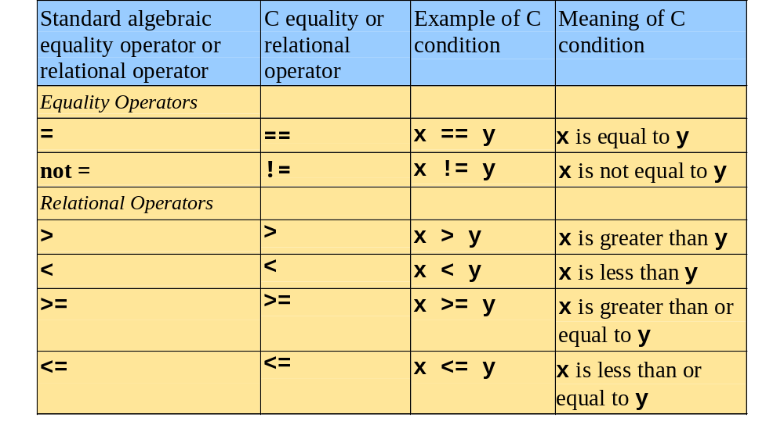
Relational Operators

Slide 10
Logical (Boolean) Operators
Binary Operators
  && (and) || (OR)
Unary Operator
  ! (not)
Operand must be int
  Use float or double, the result may not predictable
  nonzero (TRUE) zero (FALSE)
Result is int
  1 (TRUE) 0 (FALSE)
  Express connected by && or || are evaluated from left to right, and evaluation stops as soon as the truth or falsehood of the result is known. i.e. ‘expr1 && expr2’ is not equal to ‘expr2 && expr1’. This is called short-circuit evaluation.
  ‘inward == 0’ normally be written as ‘!inward’
      Example:
      3 < 7 < 5
      3 < 7 && 7 < 5
Example:
Expression Result
5||3
5||0
5&&3
5&&0
i&&j (if i=0, j=0)
i&&j+1 (if i=5, j=0)
!5
!0
!i (if i=5)
1
1
1
0
0
1
0
1
0
(3 < 7) < 5 1 < 5 1
1 && 0 0

Slide 11
Conditional (ternary) Operator
Syntax
    expr1 ? expr2 : expr3
  If expr1 ≠ 0, then execute expr2 and ignore expr3
  If expr1 = 0, then execute expr3 and ignore expr2
  Example: x = i+j ? i+1 : j+1
  Example:
  x = 5 ? 4 : 2; /* x = 4 */
  Example:
  j = 4;
  i = 2
  x = i+j ? i+1 : j-1 /* x = 3 */
  Example:
  l = a > b ? a : b; /* the larger of a and b */
  Example:
  max =(a > b)?((a>c)?a:c):(b>c)?b:c);
  /* the maximum number among a, b, and c */
  Example:
  x = a > 0 ? a: -a; /* the absolute value of a */

Slide 12
sizeof Operator
Syntax
    sizeof(expr)
  The number of bytes occupied by expr
  For most computers
    sizeof(3) 2 or 4 (bytes)
    (depending on16 bit CPU or 32 bit CPU), where 3 is an integer
    sizeof(3L) 4 (long int)
    sizeof(3.0) 8 (double float)
  Example:
    double i;
    printf(“%d”,sizeof(i)); 8
  Usually, this operator is used to get the size of an organized variable (like struct, union, …)
  This is one of a few functions that are built-in. No #include is required.

Slide 13
Address Operator
Syntax
  &var
  Get the address of the variable
  & means the address of var
  Type of var may be
    (a) fundamental data type
    (b) organized data type
  Example:
  int i=100;
  printf(“%d %d”, &i, i);
Address
Content
1000
1001
RAM
1002
100
1003
1004
1005

